Slide 1

C379 Emerging technologies
Lesson 18: Decision Trees

Slide 2

L18 Learning Objectives
Apply Decision Tree algorithm to a train predictive model
Test and evaluate the Decision Tree model
Explain and effectively present results to end-user devices

Slide 3



Model Building
Decision Trees

Slide 4
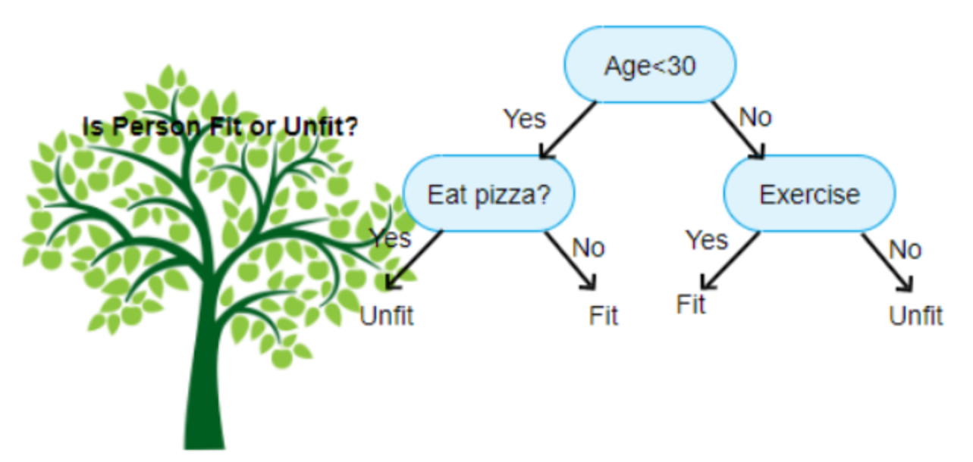
Decision Tree
Classification trees are popular because they are transparent, straightforward and easy to understand how they produce the predictions. They can be used for regression or classification tasks.
They produce the predictions by creating a series of rules that applied consecutively until they arrive at a "leaf" node in the tree that contains the classification.

Slide 5
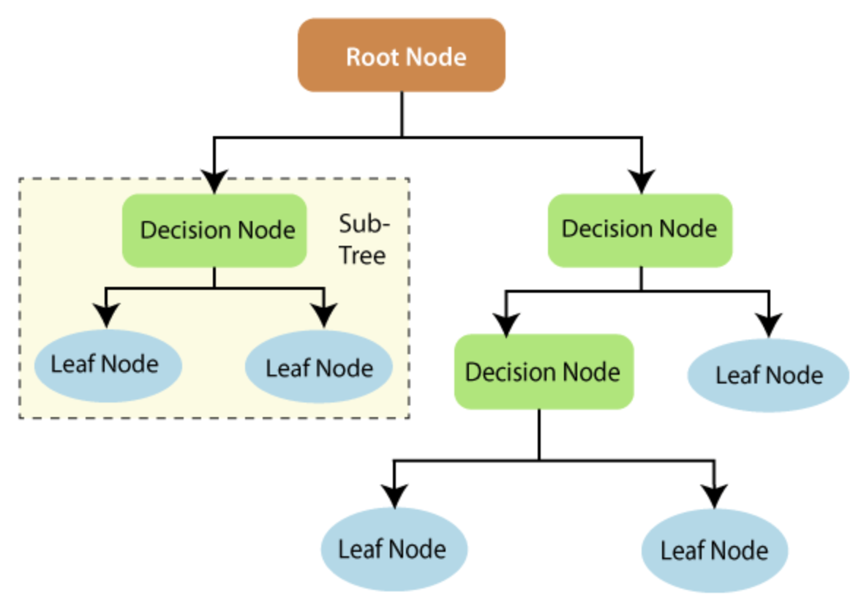
Decision Tree
One of the main drawbacks of Decision Tree is that they are very prone to over-fitting – It can do well on training data but are not so flexible for making predictions on unseen samples.
However, the model is simple, and the results are easy to interpret.

Slide 6
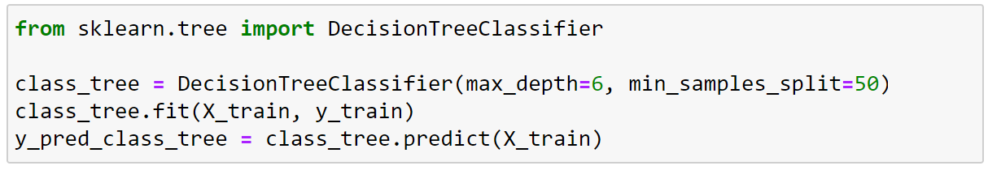
Decision Tree Classifier
1. Importing decision tree method from scikit-learn framework
2. Calling DT method with a maximum depth of the tree (= 6) and the minimum number of samples required to split (=50) as parameters
3. From the training dataset and labels provided in the parameters, this method train the model to make prediction.
4. The predict method is used to classify incoming data point
X_train matrix contains all the features of the training set
y_train matrix contains the label from the training set

Slide 7

Lab Demonstration
Lab 18-1
Using a Decision Tree Model

Slide 8

Decision Tree
Lab 18-2
Build A Binary Tree Model To Solve Laundromat Problem

Slide 9
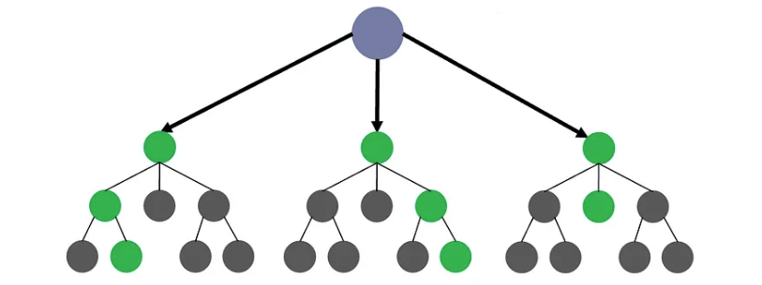
Unscheduled Asynchronous e-learning
Watch the following videos before Lesson 19:
Random Forest - https://www.youtube.com/watch?v=J4Wdy0Wc_xQ
60 mins

